Slide 1
Autism Digital Assistant
Prototype Study
Team Members:
Heney S Panicker HT035943M
Huang, Donghao HT035913N
Jerel Yam Wye Kede HT065749W

Slide 2
Outline
Introduction

Slide 3

Introduction
The purpose of the ADA project is to use PDAs to assist people diagnosed with autism in learning environments and real life situations.
Since most autistic people think visually, symbols are widely used in ADA.

Slide 4
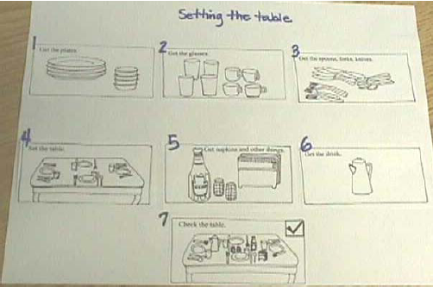
Task Organizer (Work System)
The use of task organizers helps autistic children who may be unsure of the steps of an activity
Task organizers are visual cues that show the steps of an activity
They provide a visual representation of each part of a task so a child always knows the next step
Pictures and/or written instructions (similar to a recipe) can be used to help children complete the sequence of a task in the right order.

Slide 5
Technology
Server
  SQL Server 2005
PC Client
  .NET Framework 2.0
  Windows Forms
Pocket PC Client
  .NET Compact Framework 2.0
  SQL Server 2005 Compact Edition

Slide 6
System Architecture
Application | OS | Description | Assigned To
Control Centre | Windows | Maintain data in Device and User tables | Heney
Symbol Manager | Windows | Maintain data in Category and Symbol tables | Heney
Work System | Windows | Maintain data in Schedule and Activity tables | Jerel
Analyzer | Windows | Analyze data in Schedule and Activity tables | Donghao
Synchronization Pocket PC | Windows Mobile | Synchronize data between SQL compact edition and SQL server 2005 | Donghao
Work System Pocket PC | Windows Mobile | Execute work system and maintain data in Schedule and Activity tables in SQL compact edition | Jerel

Slide 7
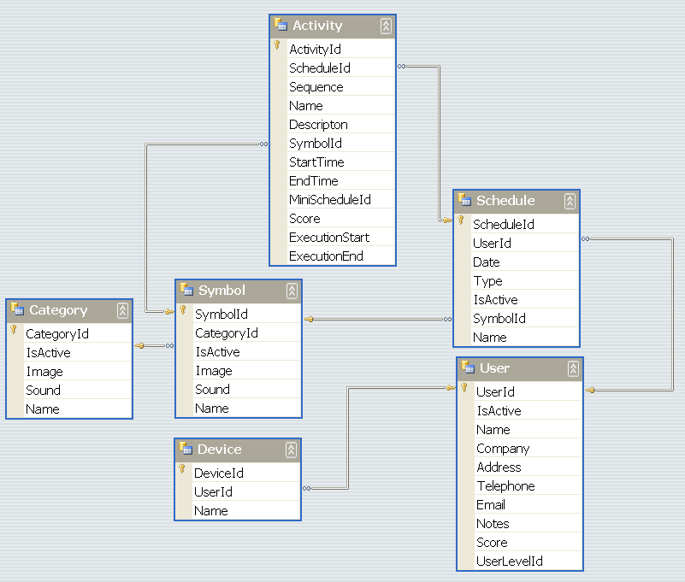

Database Schema

Slide 8
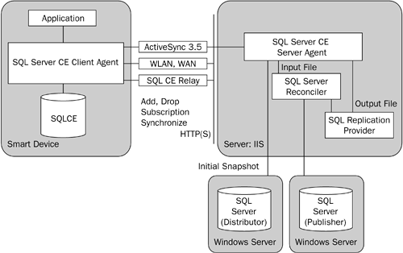
Data Synchronization (1)
Introduction to Merge replication
Add something

Slide 9
Data Synchronization (2)
Configuration of merge replication

Slide 10
Data Synchronization (3)
SqlCeReplication repl = new SqlCeReplication();
repl.Publisher = (string)Setting.LocalSetting.GetValue("Server", "WIN2003");
repl.InternetUrl = string.Format("http://{0}/ADA/sqlcesa30.dll", repl.Publisher);
repl.PublisherDatabase = @"ADA";
repl.PublisherSecurityMode = SecurityType.DBAuthentication;
repl.PublisherLogin = @"ada";
repl.PublisherPassword = @"p@ssw0rd";
repl.Publication = subsriptionName;
repl.Subscriber = subsriptionName;
repl.SubscriberConnectionString = ("Data Source =" + (_databaseFilePath) + (";Password =" + "\"\";"));
repl.HostName = _deviceID;
if (!File.Exists(_databaseFilePath))
{
repl.AddSubscription(AddOption.CreateDatabase);
}
repl.Synchronize();

Slide 11
Conclusion

